Slide 1

How to book a
Private Road Test

Slide 2
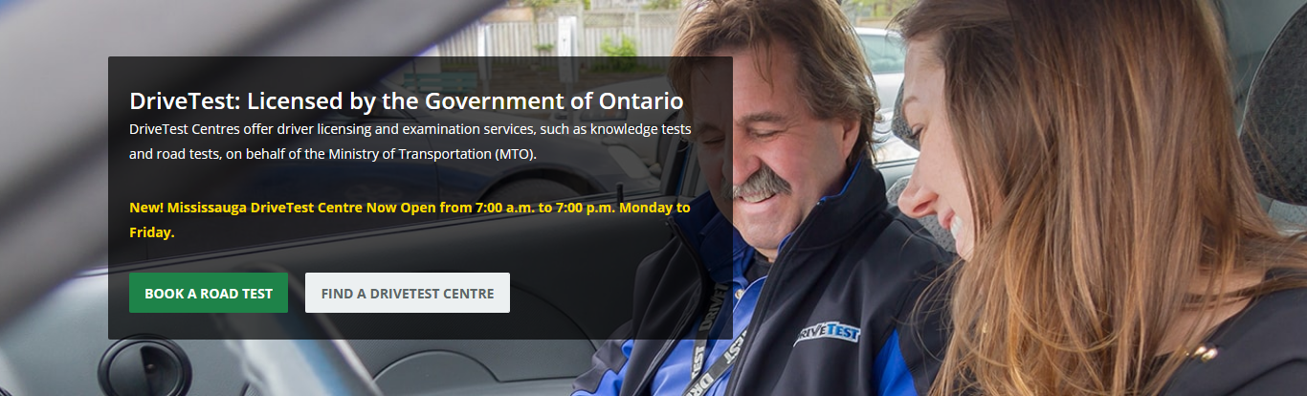
Step 1 : go to drivetest.ca

Slide 3
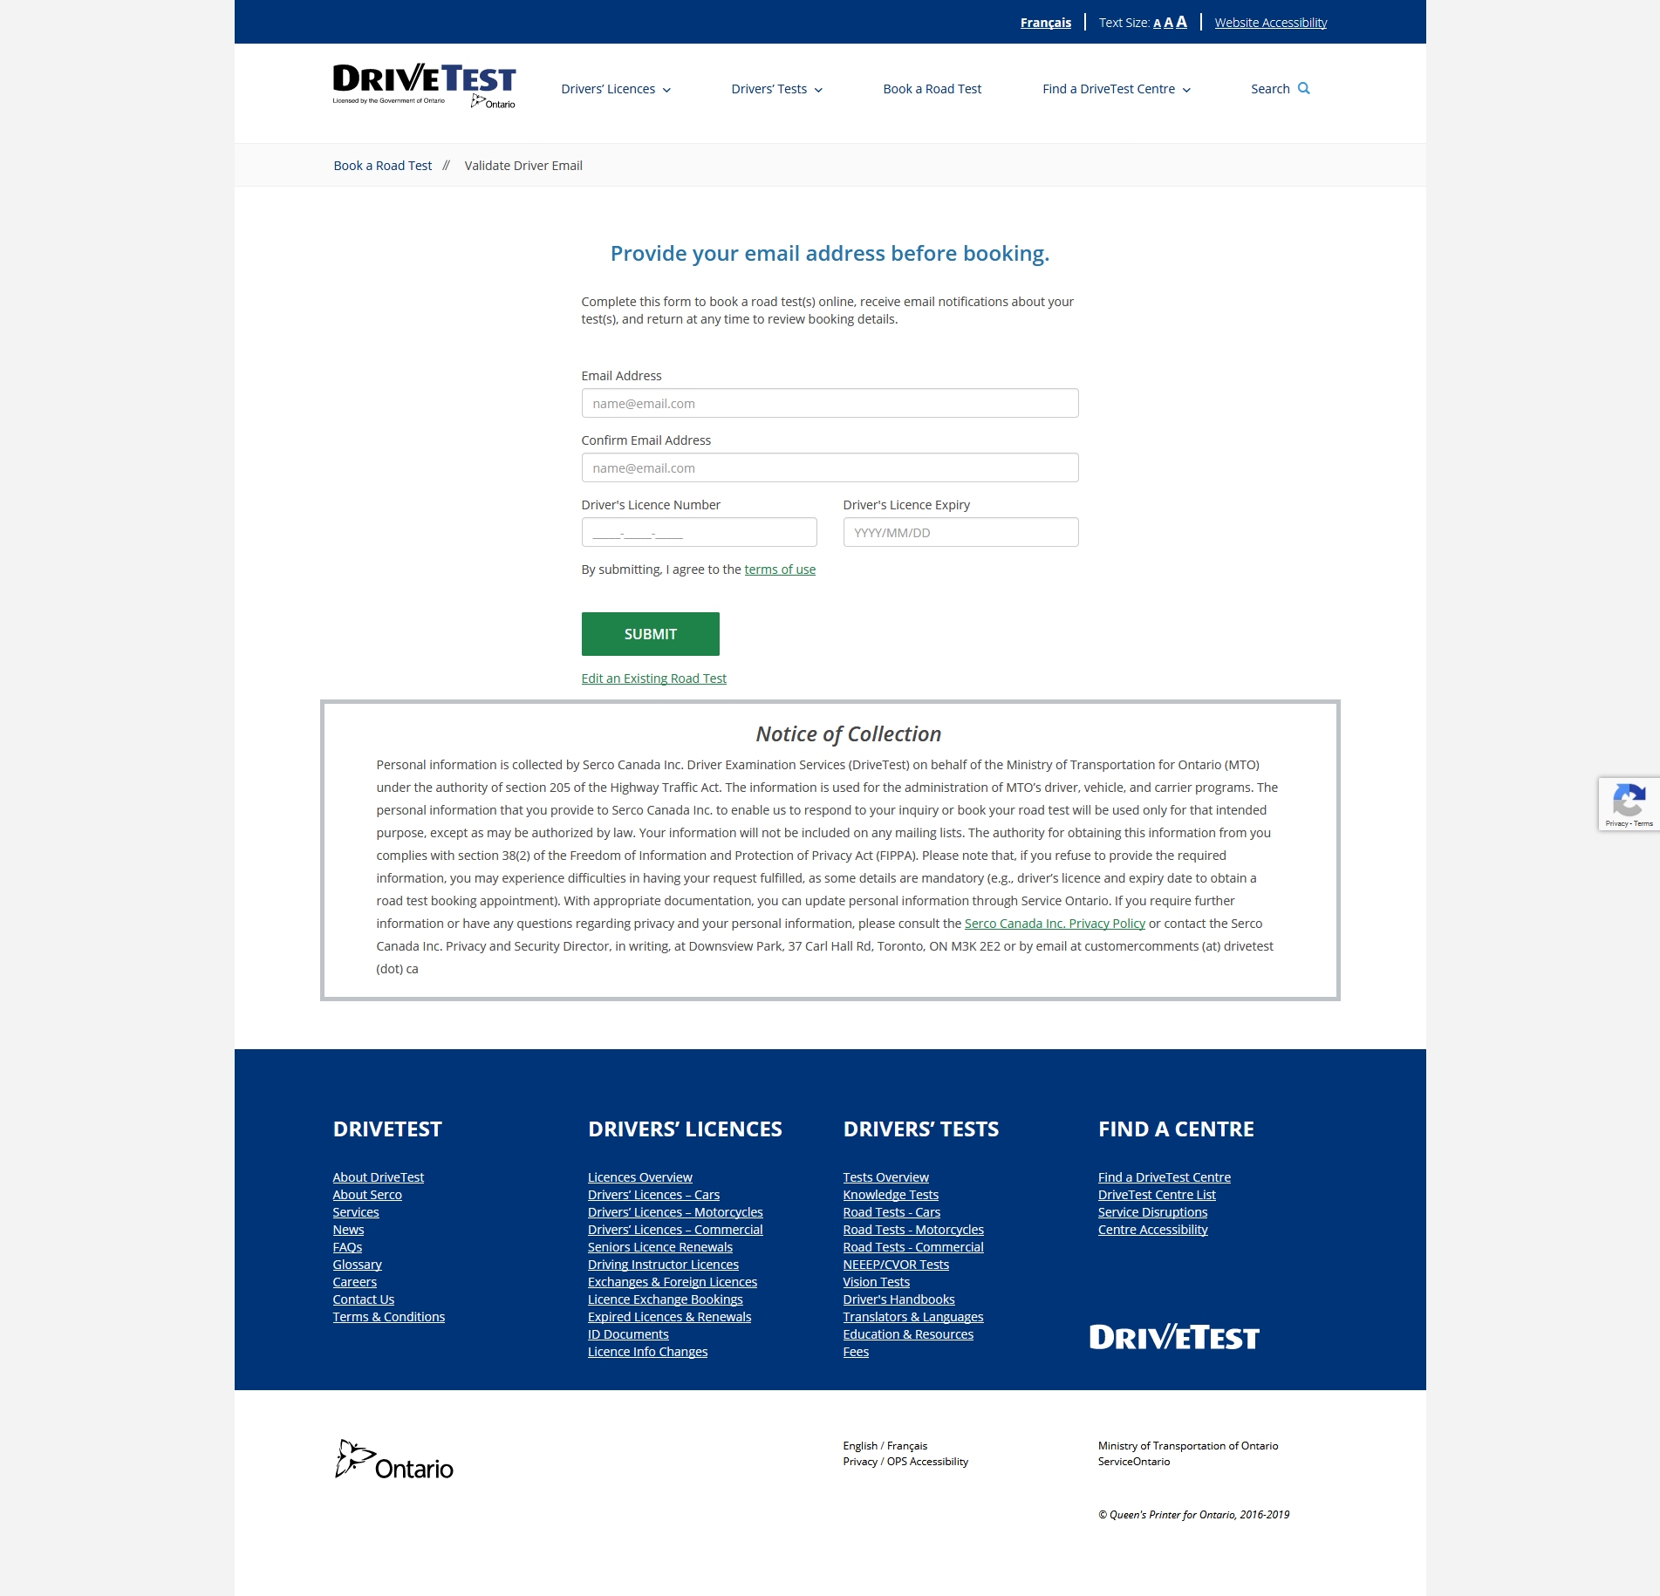
Step 2: use your email address and student drivers license and expiry date

Slide 4
Step 3: you will need to check your email and click the verify button.
This will open a new window. On this page you will need to type in the drivers license and expiry date again and hit the green submit button.

Slide 5
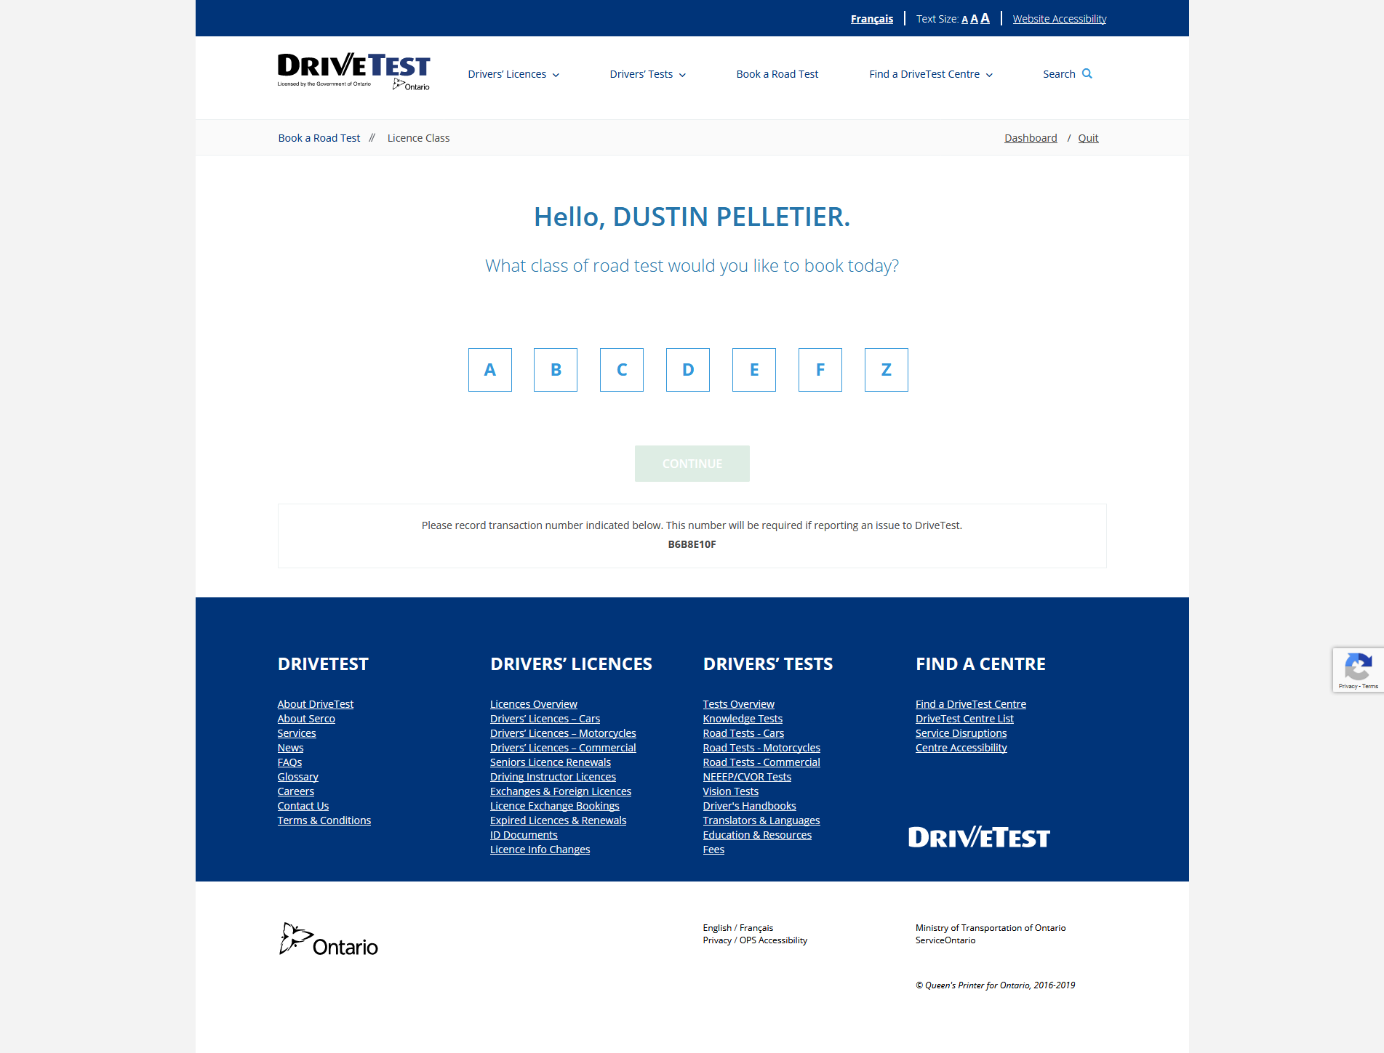
Step 4 : select the class of license you are booking.

Slide 6
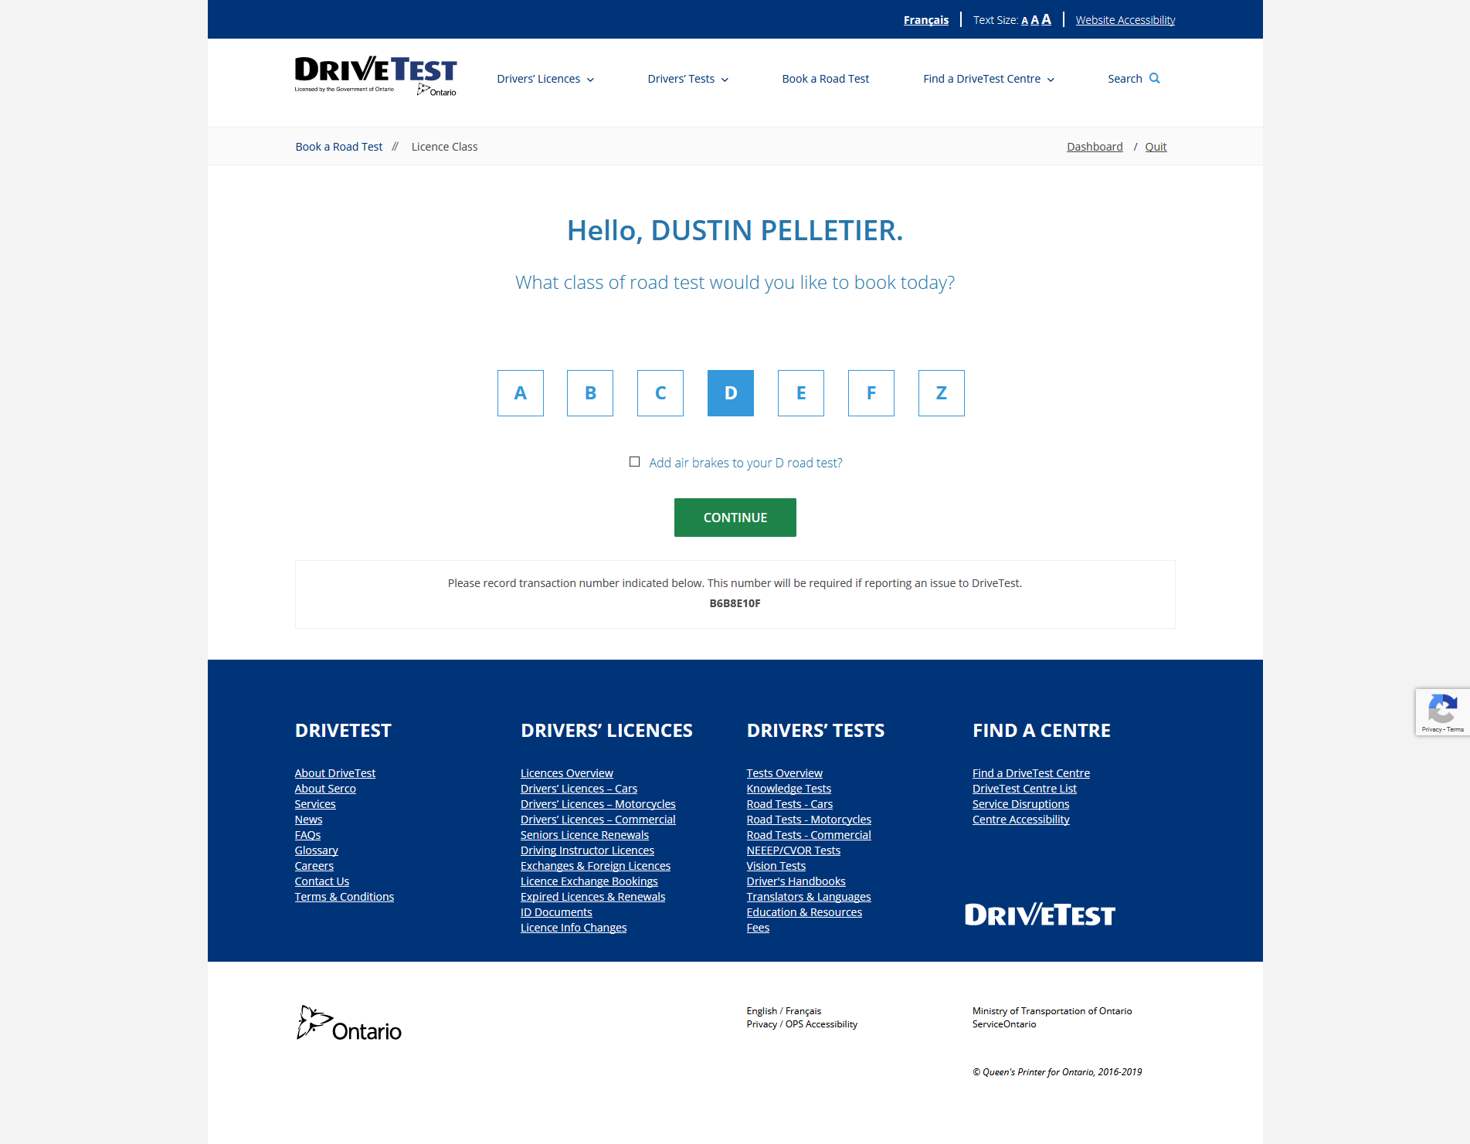
Step 5: Do not click the add air brake to test box.

Slide 7
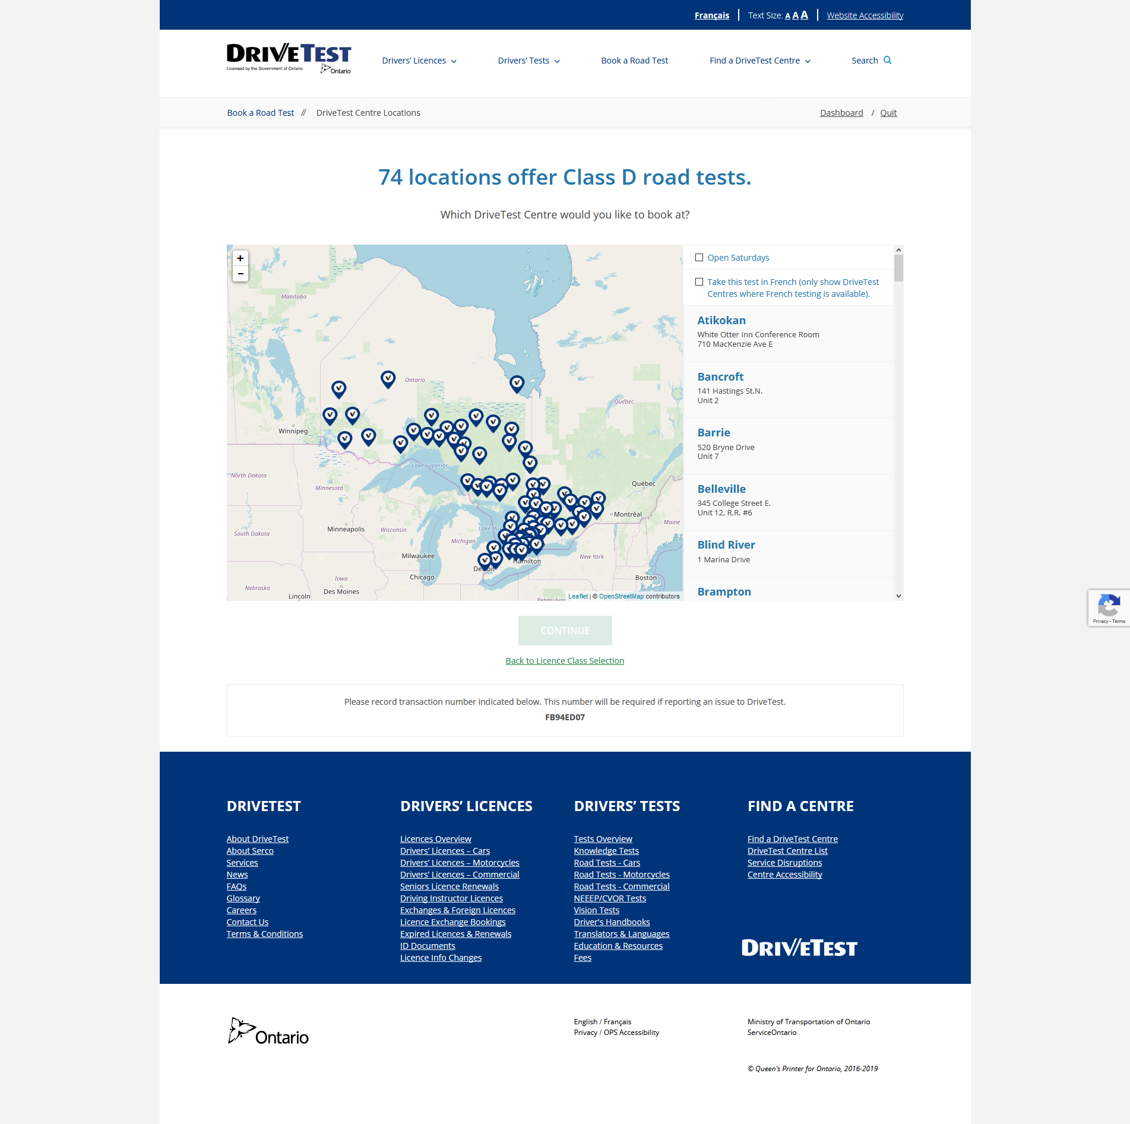
Step 6: Scroll through the list until you find the location you want to book in.

Slide 8
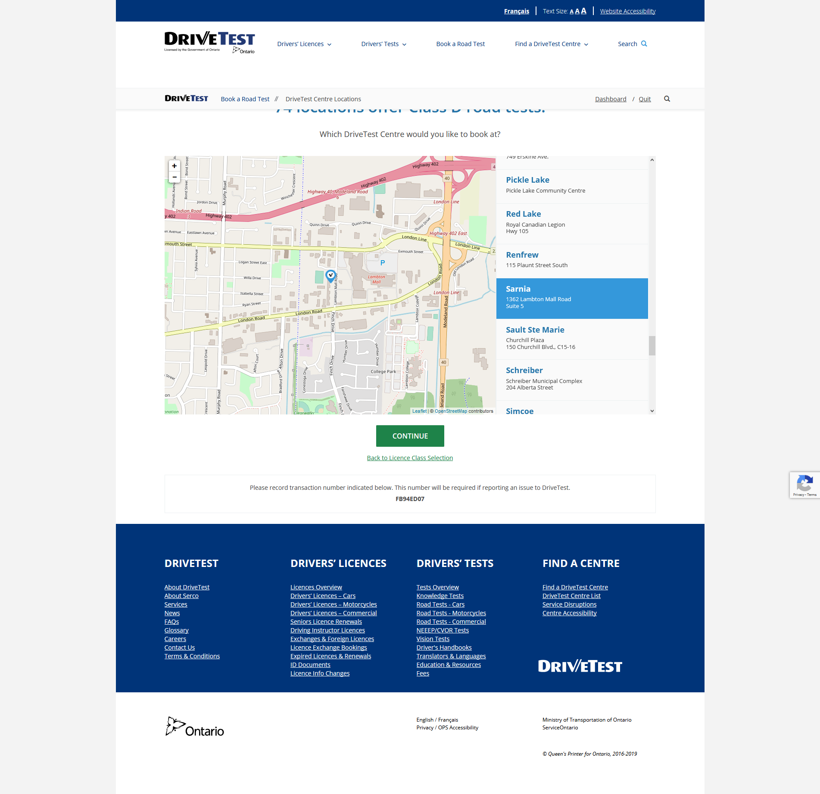
Step 7: Click continue

Slide 9
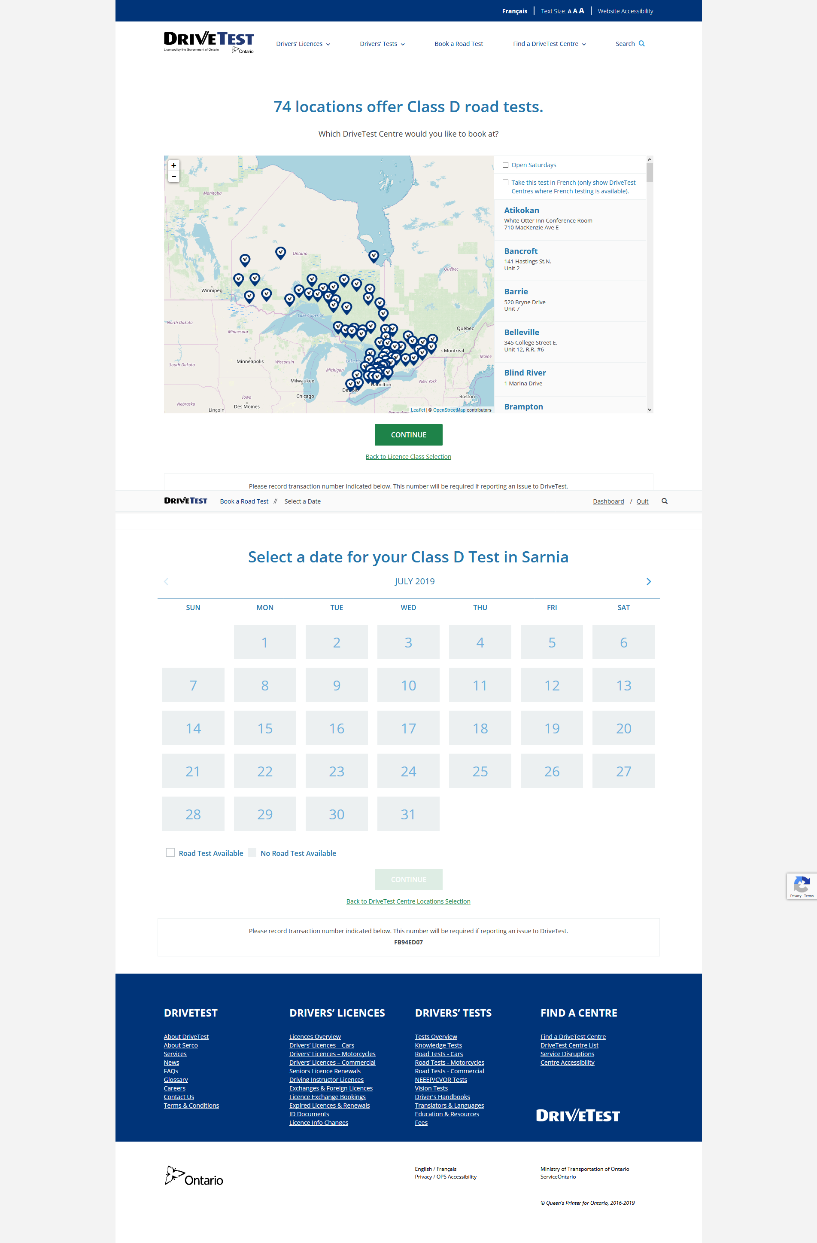
Step 8: Find a date, the greyed out boxes are not available, click the arrows at the top to change months. Available dates are white.

Slide 10
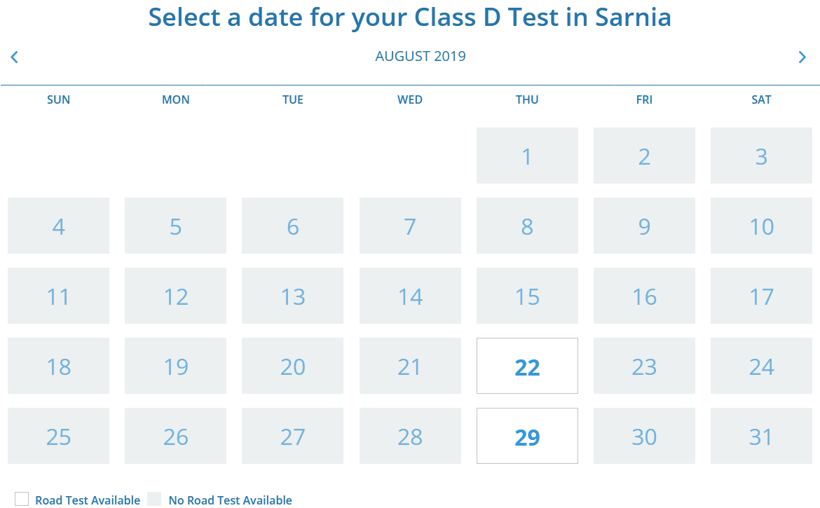
Step 9: Select a date.

Slide 11
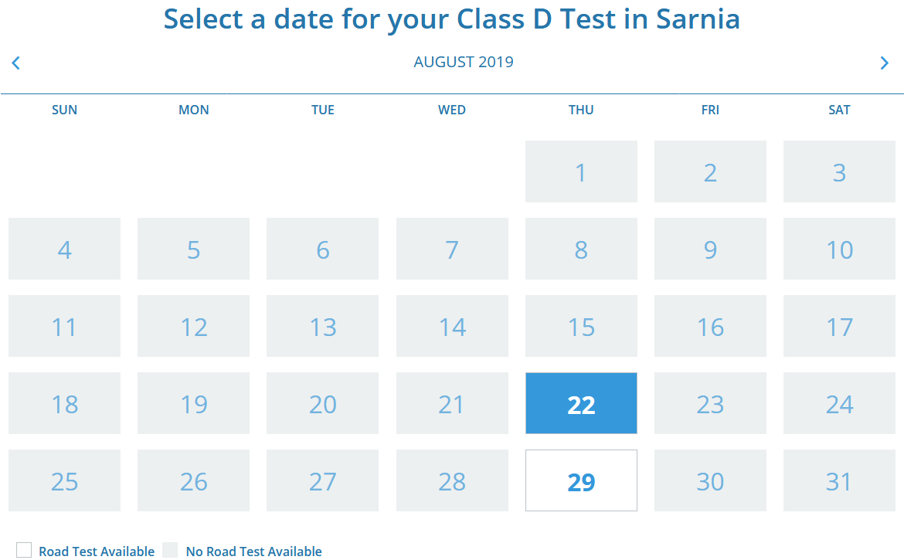
Step 10: Selected date turns blue, hit continue.

Slide 12
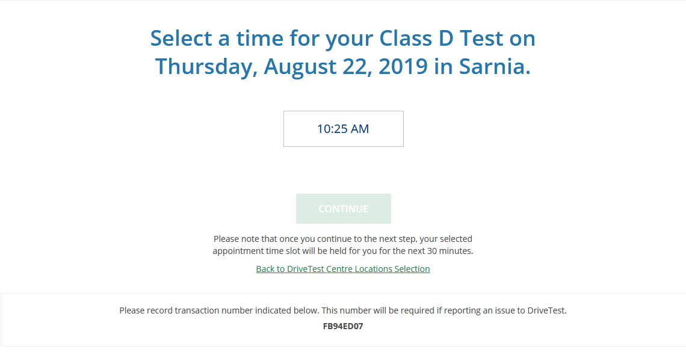
Step 11: Select the time you would like.

Slide 13
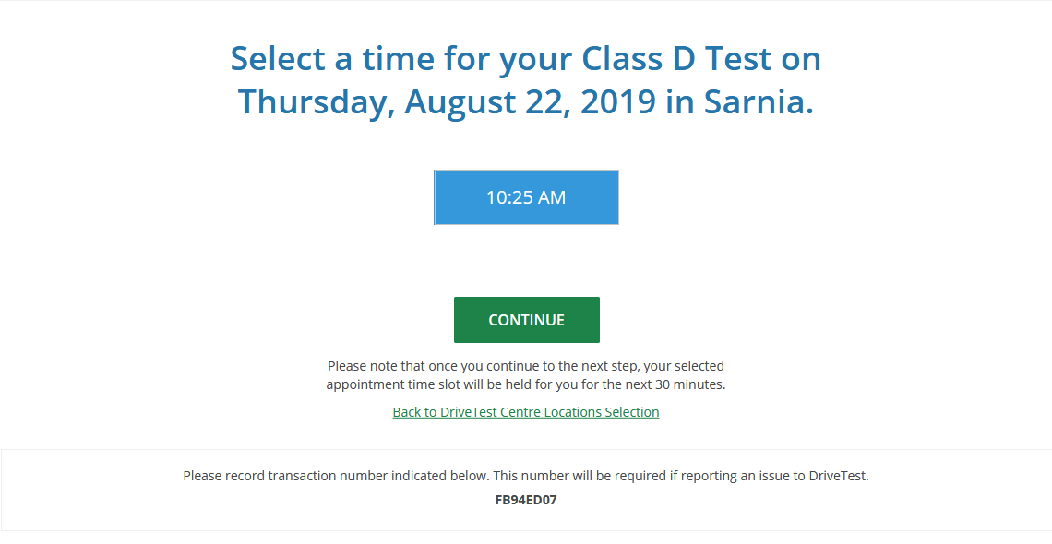
Step 12: Click continue.

Slide 14
Step 13: Check the check here box.
Submit will then turn green. Click that and a confirmation screen will appear and you will get a confirmation email.

